Slide 1

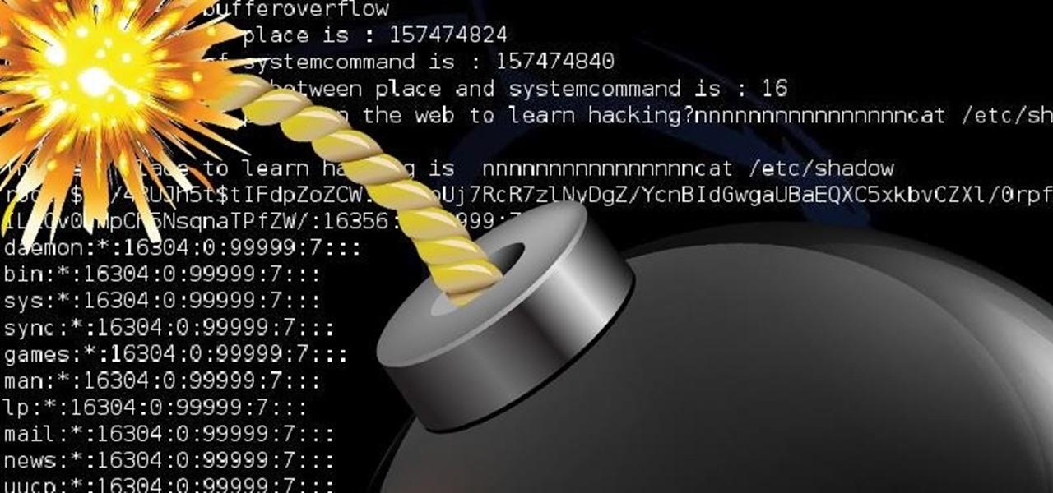
Solving Memory Buffer Overflows
By Christian Gonzaga

Slide 2
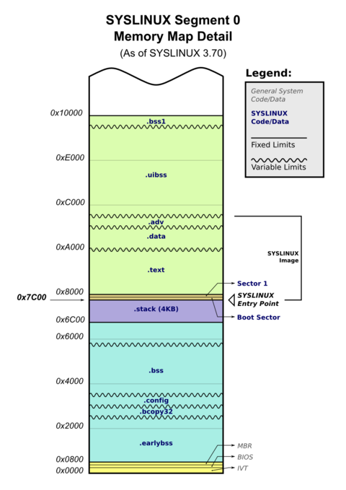
Introduction to Buffer Overflows
What are Memory Buffers?
Picture a process in memory, which contains a stack, heap, data and text.
There exists, a Memory Buffer, which are storage for temporary memory to hold data.
What is a Buffer Overflow?
A Buffer Overflow happens where the amount of data goes over the limit of the storage capacity inside a memory buffer.
There are many types of Buffer-Overflows. For my example, I will explain a Stack Buffer-Overflow

Slide 3
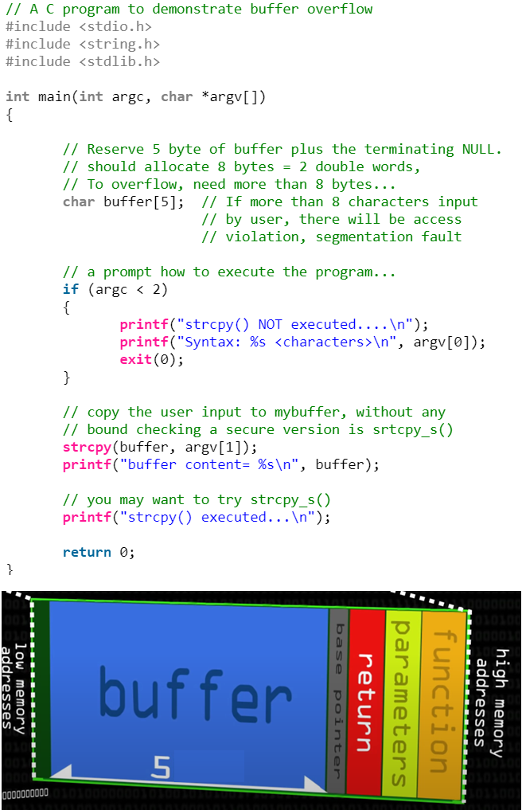
Simple Buffer-Overflow Program
Let’s imagine we have this code saved on our Linux Operating System as vul.c
Note that the program has a char buffer[5]
On the Terminal Command Line, I called this program by typing:
vul.c 12345678
The program will run smoothly. Since this input(8 bytes) fits in the char buffer[5].
BUT what if I called this program:
vul.c 123456789
The program will run. This time, it will give us a familiar output: segmentation fault.
Ques: Ever wonder what’s a segmentation fault?
Ans: It means our input (123456789) of buffer[5] has flooded into base pointer section!
Segmentation fault warns us we’re accessing a memory stack which we are not supposed to (In this case, it flooded into the “base pointer” section.

Slide 4
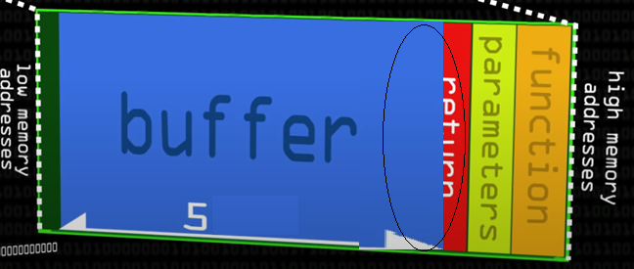
Simple Buffer Oveflow (Continued)
Hackers can crash the program by overloading the buffer with a massive bytes of input. However,……
..Instead of crashing it, they can manipulate the memory flow at the virtual location of the “return 0” line
This is where they take advantage by insert malicious code into the memory. This is known as Buffer-Flow Exploitation
Which leaves us to the potential damage of it.

Slide 5
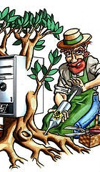


Potential Damage of Buffer-Overflow Exploitation
When a hacker exploit Buffer-Overflows, he/she becomes Thanos. They can wreak havoc on the operating system with a snap of their fingers (Just an analogy!)
“After the snap”….They can take control of the computer, using Root-kit program.(Remember, this can be done by using Linux GDB and Analytics)
Implement keylogger program, a malicious software where it can “quietly” trace owner’s keyboard data and send it to the hacker’s database system.
Apply Ransomware, another malicious program where it locks the original owner from file access.
Crash the program by overloading the memory capacity but imagine a program that controls network and satellite technologies. So yes, catastrophic consequences may occur.

Slide 6
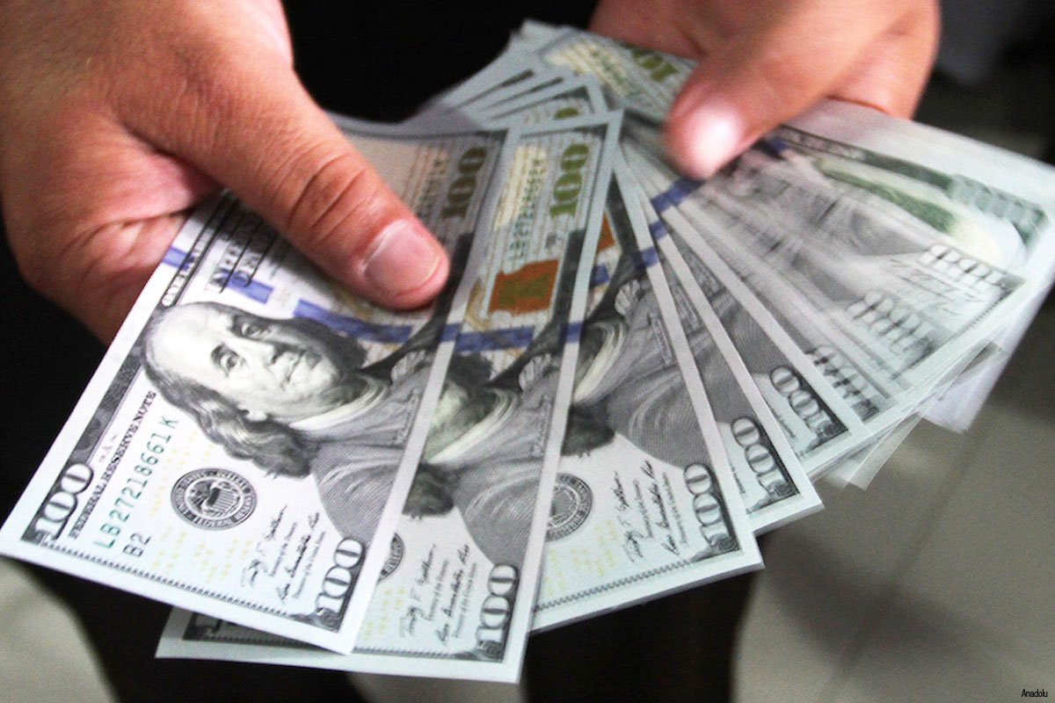

Some Information about Buffer Overflows
One famous example of a Buffer-Overflow in video games: “The Missing-no glitch” from Pokemon Red.
Web Applications are more popular than ever Desktop-based Applications. Problem is, Web Applications are more prone to vulnerabilities and difficult to fix them than its Desktop counter part.
According to a Gartner Group Report, 70% of Vulnerably are found in Software Applications. Buffer- Overflow was the most occurring vulnerabilities. [ref]
Software Engineers & Developers should enroll for Security Coding Programs and practice safe secure coding techniques at all cost! One error code can cost millions of dollars and cause the prospect of being unemployed!!
But don’t worry! there are many ways to counter Buffer-Overflows. One way is to detect them and prevent them from happening!

Slide 7
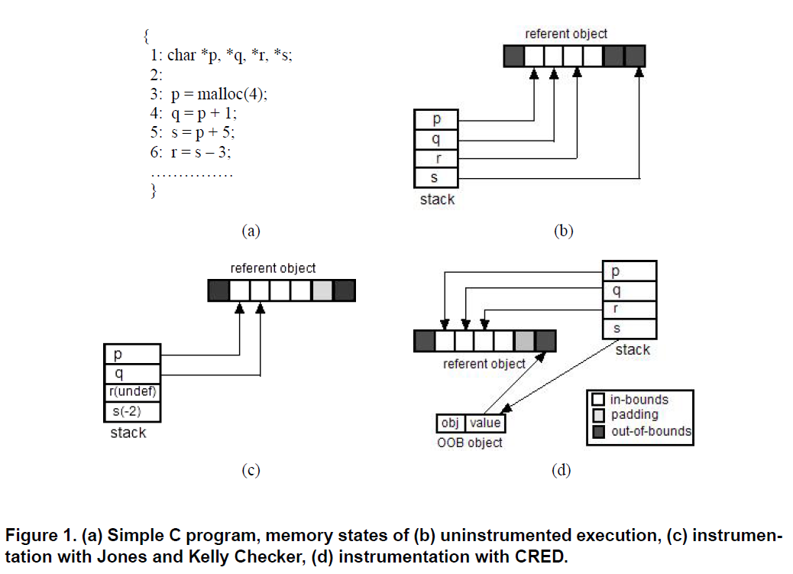
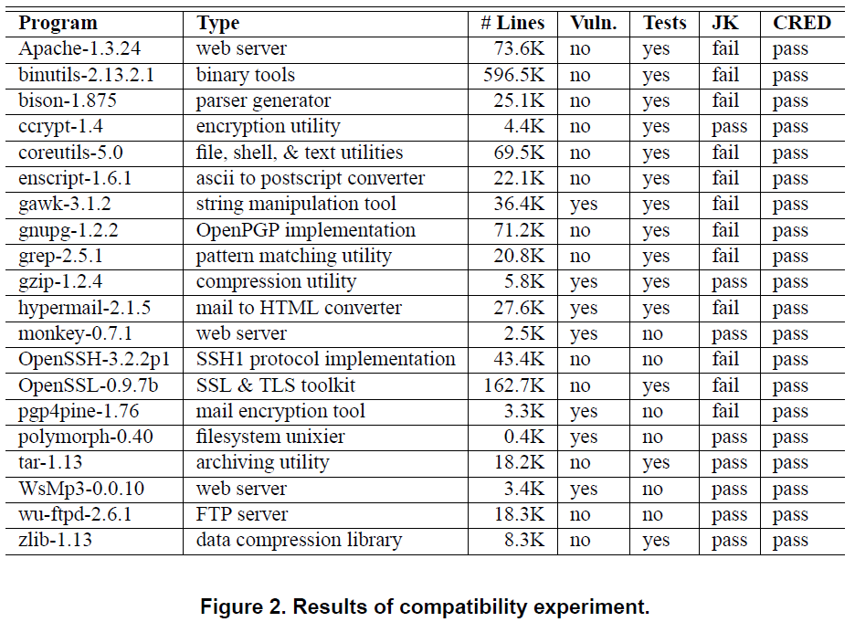
Detecting Buffer-Overflows
One best way to detect Buffer Overflows is using a dynamic bounds checker. It detects buffer overflows in a software before it occurs. Therefore, it prevents attacks from wrecking the system.
Downfalls: Dynamic Bounds Checker can break existing code of the software, and it cannot guard ALL buffer overrun attacks
Lam and Ruwase introduced an effective Dynamic Buff Overflow Detector, known as C-Range Error Detection (CRED)
The Design Idea of CRED:
Replace every out of bounds pointer value with Specialized Out Of Bounds Object created for that value (OOB objects contains the actual pointer value and information)
When this value is needed, it will be replaced by the actual out of bounds address
The pointer derived from this address will be bounds checked before it can be dereferenced(or used). Thus, it detects potential of Buffer Overflows before it has happened .
Their results showed that CRED did not break any existing code after testing 20 different buffer overflow attacks. CRED is also more significantly more efficient by limiting the buffer overrun checks to strings.

Slide 8
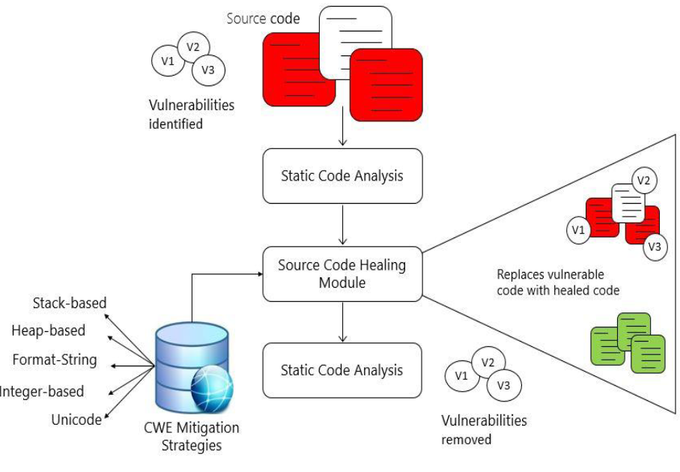
Applying Automated Approach to Fix Buffer Overflow
There are various techniques to fix buffer overflows, including manual and automated tasks.
Manual approach to solve Buffer Overflows are time-consuming and prone to programming errors.
There has been a huge increase of cyber attacks, and not many software developers are equipped with “secure code knowledge.” Some automated techniques to fix Buffer Overflows are flawed.
In 2019-2020, Shabib, Alenezi, Naddem, Asif developed their own automated but better design (Of fixing Buffer-Overflows) to address the previous concerns. The design is a Software Self-Healing Framework
Their development is based on extensive research from Common Weakness, and Enumeration (CWE) articles and other public security vulnerability repositories.

Slide 9
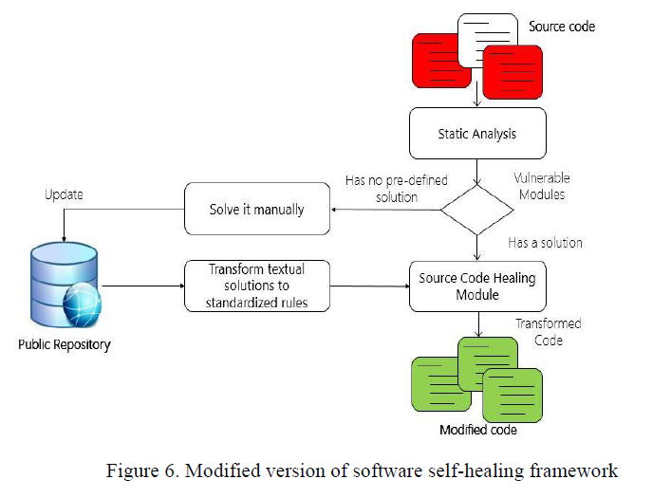
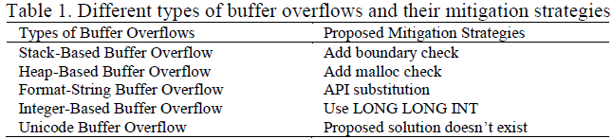
What was their design?
They applied a Buffer-Overflow detector, that can scan five different types of Buffer Overflows.
They used Static Analysis tools (over Dynamic Analysis) since it has a better accuracy of finding vulnerabilities
Once a vulnerability has been found, the program will automatically replace the “bad source code” with a “Heal-Source Code.” Thus, creating a safe secure modified programs.
Their heal code are based on Proposed Mitigation Strategies by CWE Community.
Their program gets to be manually updated from Public Repository when new vulnerabilities are discovered
Let’s look how it looks like in each different buffer-overflows!

Slide 10
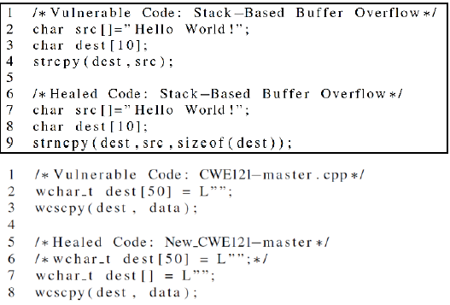
Stack-Based Buffer overflow
Stack-based can be fixed by inserting boundary checks.
Here, we see strncopy has the size of the destination buffer and copy these bytes till the size of its destination buffer
The researchers' design includes KIUWAN, a static Analyzer tool that detects vulnerabilities
Then their own code, it removed the vulnerable code and replaced with heal code.
Their secure code is based on CWE Standard code.

Slide 11
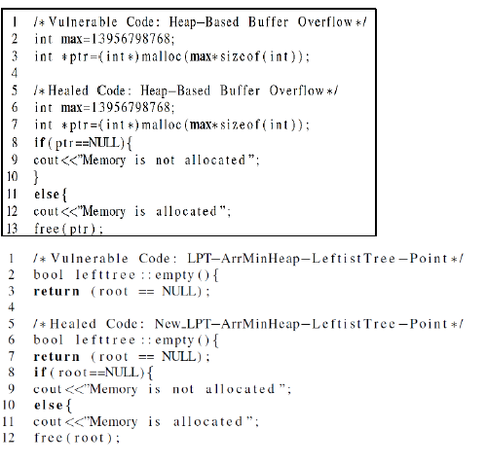
Heap-Based Buffer-Overflow
This type of Buffer Overflows happens in the heap data area. It occurs when a chunk of memory is allocated to the heap and there is no bound checking being applied on the data. Can be fixed by adding a malloc function
Another method includes updating memory table upon the allocation/deallocation of the memory chunks. The table is used to create constraints.
The experimenter's healed code is shown at the right.

Slide 12
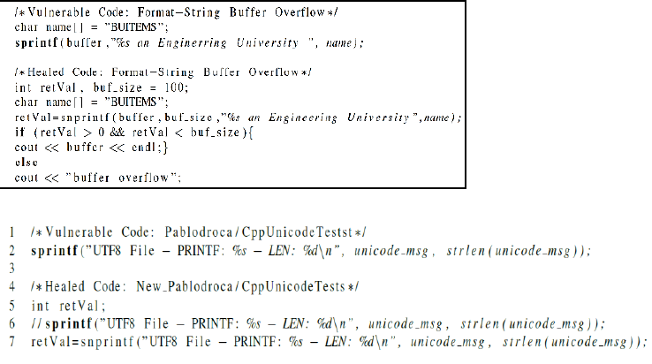
Format String Buffer-OverFlows
Occurs when data and control information are combined. Text strings are automatically converted to largest formats, sprint f function is the culprit that causes this Overflow.
Adding snprint is used to check the length of the buffer, copies a determined number of bytes with If-else check for.

Slide 13
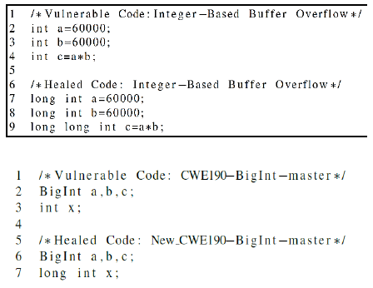
Integer-based Buffer Overflow
This type of Buffer Overflows occurs when a number value exceeds the maximum or minimum range. For example, adding 100 and 200 can overflow an 8-bit container.
A simple fix can be implemented by changing the data type from INT to LONG LONG INT.

Slide 14
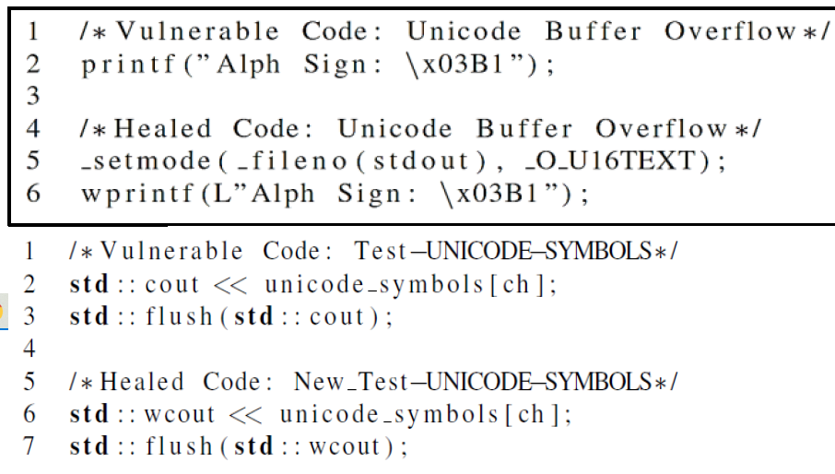
Unicode Buffer Overflow
Occurs where inputing Unicode chars into an input that expects ASCII characters. (note: ASCII covers only western language characters)
Printing Alpha having code “nx03B1” which return a garbage value.
To fix Unicode buffer overflow, set the program into Unicode mode, repace cout,printf with wcout,wprintf respectively.

Slide 15
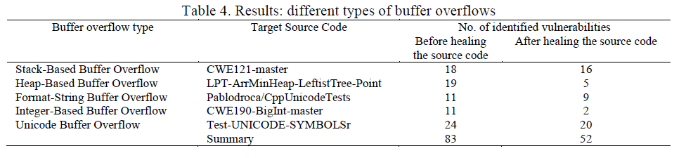
Results
Unlike other automated techniques to fix Unicode Buffer-Overflow, the experimenter's program can fix these type.
Total of 31 Buffer Overflow errors were fixed by their design based on their experiment. Targeted every type of buffer-overflows and greatly reduces the number of vulnerabilities.
Their program had more accurate of finding errors and more efficient than the manual fixing of buffer overflow vulnerability.
One draw back of their program: It’s prone to creating large data types during Integer Flowing Execution.

Slide 16
Conclusion
Buffer Overflows are bad!...REALLY BAD! They can crash programs or cause certain glitches in games
Clever Hackers take advantage of this exploitation by injecting malicious code.
Software Developers should take rules of “Secure Coding” into serious consideration.
Buffer Overflows solutions are getting better every year.
Most likely, automized secure coding will be the best technique to fix Buffer Overflows. A good fix would require finding ALL types of Buffer Overflows and replaced with “Healed” source code. Also automized techniques are better than manual approaches to Buffer Over-flows since it cost less time and errors.

Slide 17
References
[1]Computerphile (2016) Buffer Overflow Attack. Retrieved from https://www.youtube.com/watch?v=1S0aBV-Waeo&t=628s.
[2]Amir Shab, Mamdouh Naddem, Muhammad Nadeem Alenzi, Raja Asif(2020). An Automated Approach To Fixing Buffer Overflow. Internal Journal Of Electrical and Computer Engineering(IJECE) https://www.researchgate.net/publication/343367024_An_automated_approach_to_fix_buffer_overflows
[3] Olaunji Ruwase, Monica S. Lam. A Practical Dynamic Buffer Overflow Detector. https://suif.stanford.edu/papers/tunji04.pdf
[4] Glitch City Laboratories Archives https://archives.glitchcity.info/wiki/Buffer_overflow.html

